Slide 1
Polymer
• Introduction
• What are polymers?
• Where are polymers used?
• Polymers as molecules with mechanical
properties.

Slide 2
What are the properties of a polymer?
Why are polymers useful ?
Do polymers directly effect our lives?
How can we make polymers?
How can we characterize polymers?

Slide 3
macromolecule = polymer=(Poly+mer)
Linear Polymer
Branched Polymer
Ladder Form
Comb Form
Cruciform
Crosslinked Polymer

Slide 4
Polymers
Polymers are giant organic molecules
Polymerization is the process by which small molecules are joined to create these giant molecules
As the polymer molecules grow in size, the melting or softening point increases and the polymer becomes stronger and more rigid.

Slide 5
Polymers
Very large molecules (macromolecules) that are composed of smaller repeating units (monomers).
Examples:
Textile fibers: polyester, nylon…
IC packaging materials.
Resists for photolithography/micro fabrication.
Plastic bottles (polyethylene plastics).
Adhesives and epoxy.
High-strength/light-weight fibers: polyamides, polyurethanes, Kevlar…
Biopolymers: DNA, proteins, cellulose…
A
A + A A-A A-A-A …..

Slide 6
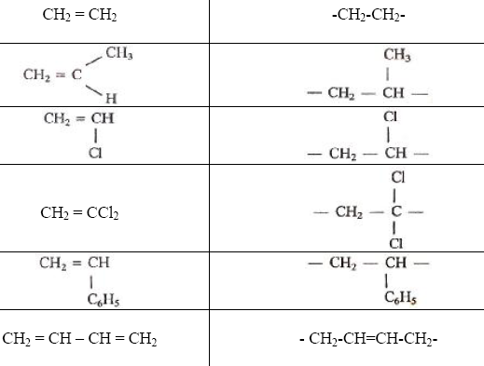
* Structural repeating Unit
* Degree of Polymerization

Slide 7
Polymer Categories and Structures

Slide 8
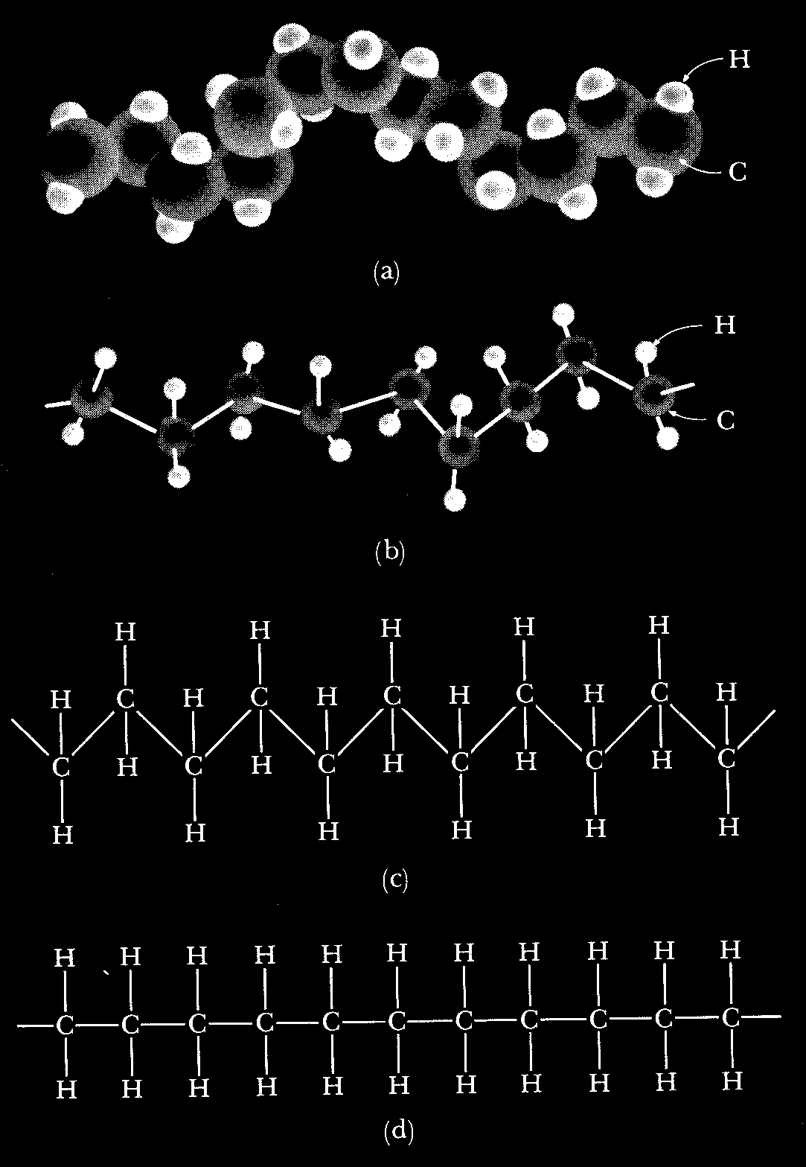
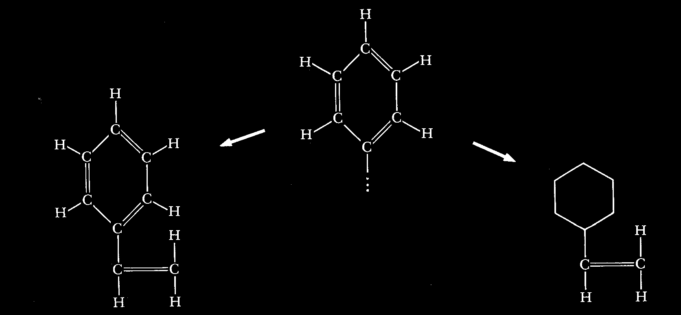
Polymer Representation

Slide 9
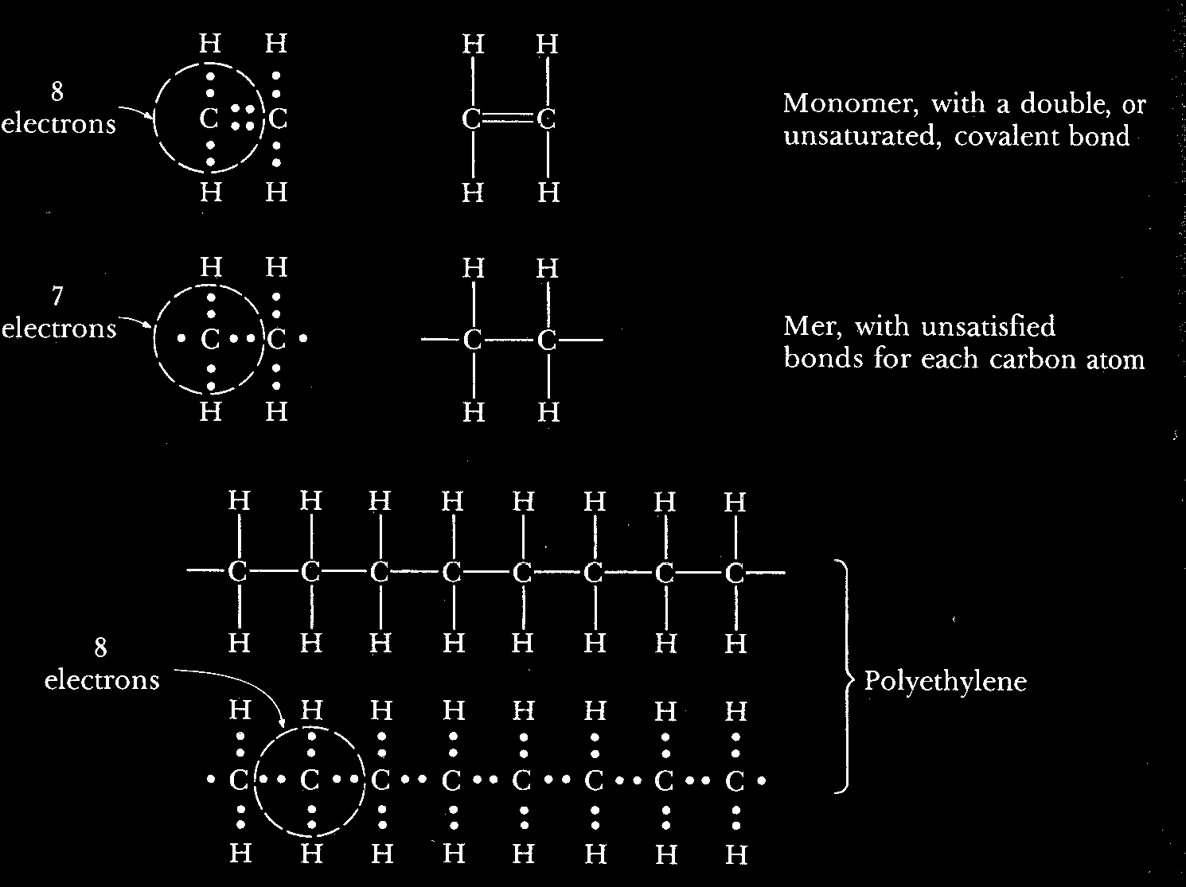
Chain Formation

